Slide 1
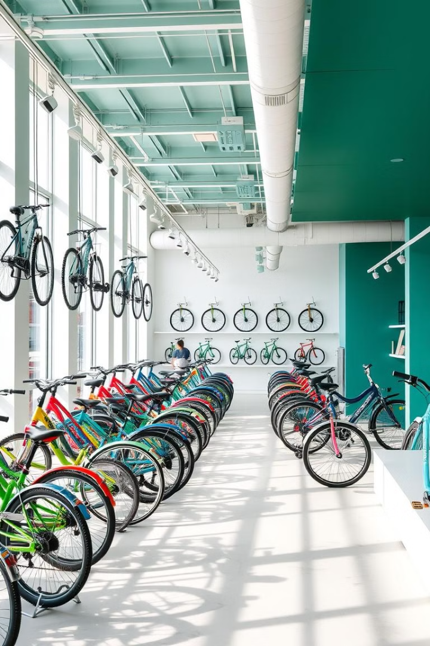

Online Bicycle Store
Welcome to our online bicycle store, where you'll find a wide selection of high-quality bikes and cycling accessories. Our user-friendly website is designed to provide a seamless shopping experience, allowing you to browse, compare, and purchase the perfect bicycle for your needs.
by Dark Forest

Slide 2
Home Page: Showcase the Products
Product Showcase
User-Friendly Navigation
Call-to-Action
The home page should feature a prominent product showcase, highlighting the store's best-selling and featured bicycles. This will capture the user's attention and encourage them to explore further.
Strategically placed call-to-action buttons, such as "Shop Now" or "Explore Collections," should guide users towards making a purchase or learning more about the store's offerings.
A clean, intuitive navigation menu should be easily accessible, allowing customers to quickly find the specific type of bicycle or accessory they're looking for.

Slide 3
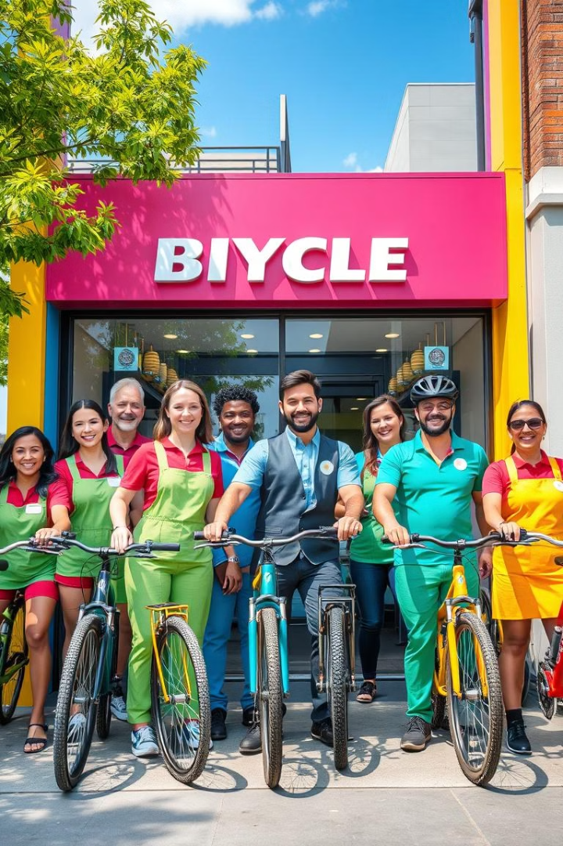
About Us: Information about the Online Store
1
Company History
2
Our Mission
Provide a brief overview of the online store's history, highlighting its founding, core values, and the passion behind the business.
Clearly communicate the store's mission to provide high-quality bicycles and exceptional customer service, fostering a love for cycling in the community.
3
Meet the Team
Introduce the store's team of cycling enthusiasts, showcasing their expertise and commitment to helping customers find the perfect bicycle.

Slide 4
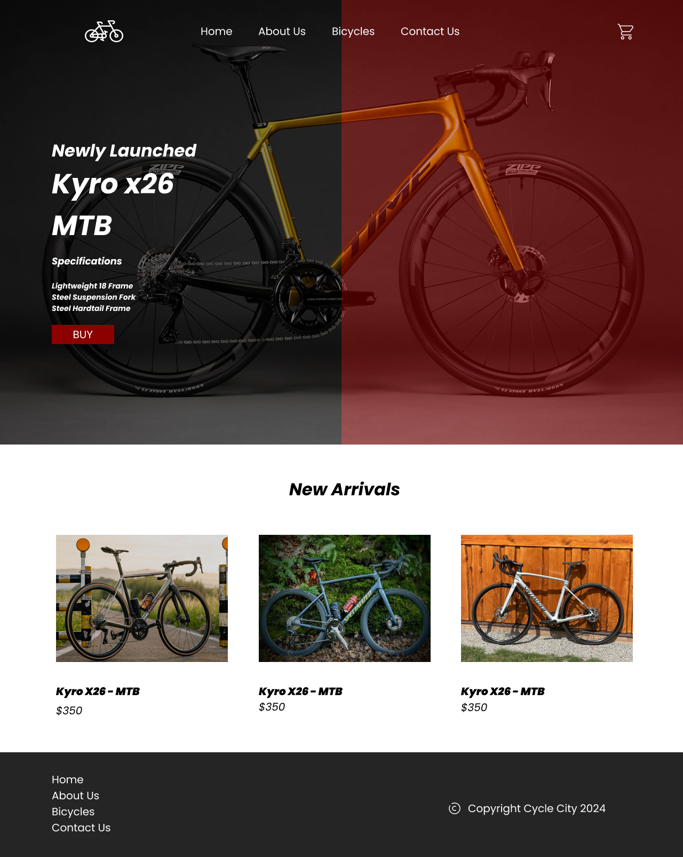
Products Page: Display All Available Products
Comprehensive Catalog
Filtering and Sorting
The products page should showcase the store's entire inventory of bicycles, organized by categories such as road bikes, mountain bikes, commuter bikes, and more.
Provide users with the ability to filter and sort products by criteria like price, brand, size, and features, making it easy to find the perfect bicycle.
Product Descriptions
Responsive Design
Detailed product descriptions, including specifications, materials, and key features, should be available to help customers make informed purchasing decisions.
Ensure the products page is optimized for various screen sizes, providing a seamless browsing experience across devices.

Slide 5
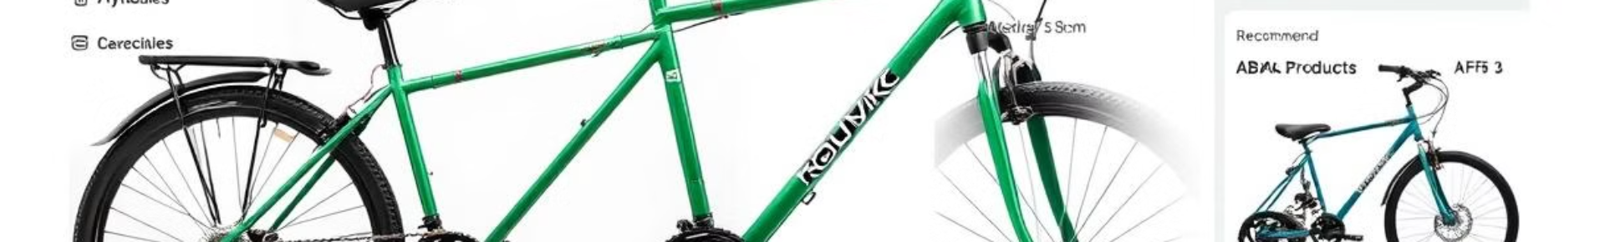
Product Detail Page: Show Details of Individual Products
Product Overview
Purchasing Options
The product detail page should provide a comprehensive overview of the selected bicycle, including its specifications, features, and technical details.
Clearly display the price, availability, and options for adding the bicycle to the shopping cart or wish list, making the purchasing process straightforward.
1
2
3
Imagery and Multimedia
Showcase the bicycle from multiple angles with high-quality images and, if possible, include interactive 360-degree views or videos to help customers visualize the product.

Slide 6
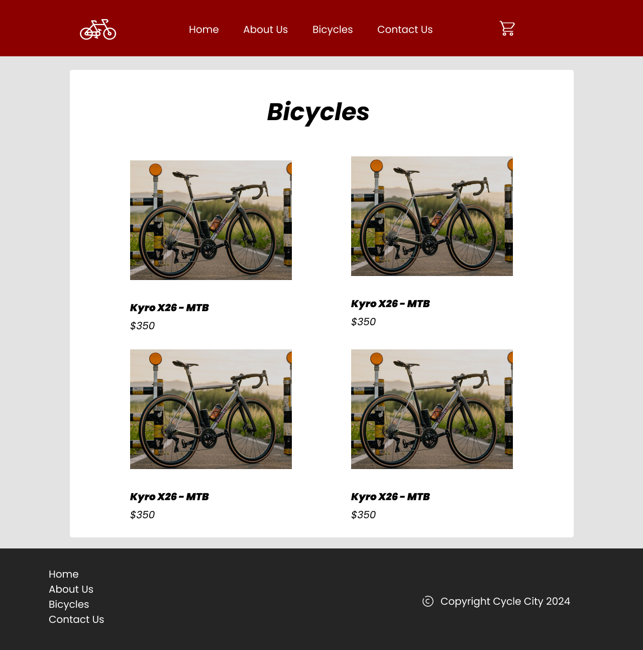




Visual Appeal: Ensure the Website is Visually Appealing
Responsive Design
Consistent Branding
Ensure the website is optimized for seamless navigation and browsing across various devices, from desktops to mobile phones.
Maintain a cohesive brand identity throughout the website, with consistent use of color schemes, typography, and visual elements.
High-Quality Imagery
Clean Layout
Showcase the bicycles and accessories with professional, high-resolution images that highlight the products' features and appeal.
Adopt a clean, minimalist layout that prioritizes user experience, with clear hierarchy and easy navigation throughout the website.

Slide 7
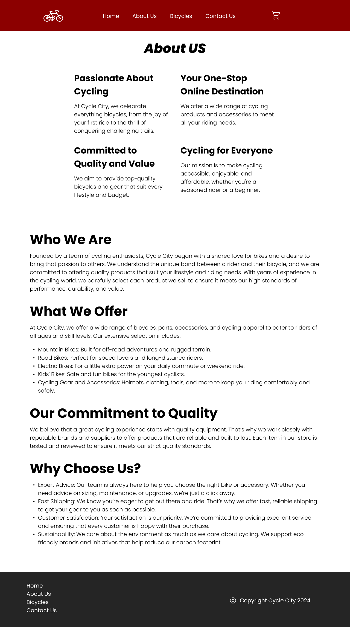



Navigation: Prioritize Easy and Intuitive Navigation
Main Navigation
Provide a clear and concise main navigation menu that allows users to quickly access key sections of the website, such as the home page, product categories, and the shopping cart.
Search Functionality
Implement a prominent search bar that enables customers to easily find specific products or browse the store's inventory by keywords or model names.
Breadcrumbs
Incorporate breadcrumbs, or a navigation trail, to help users understand their current location within the website and easily navigate back to previous pages.

Slide 8
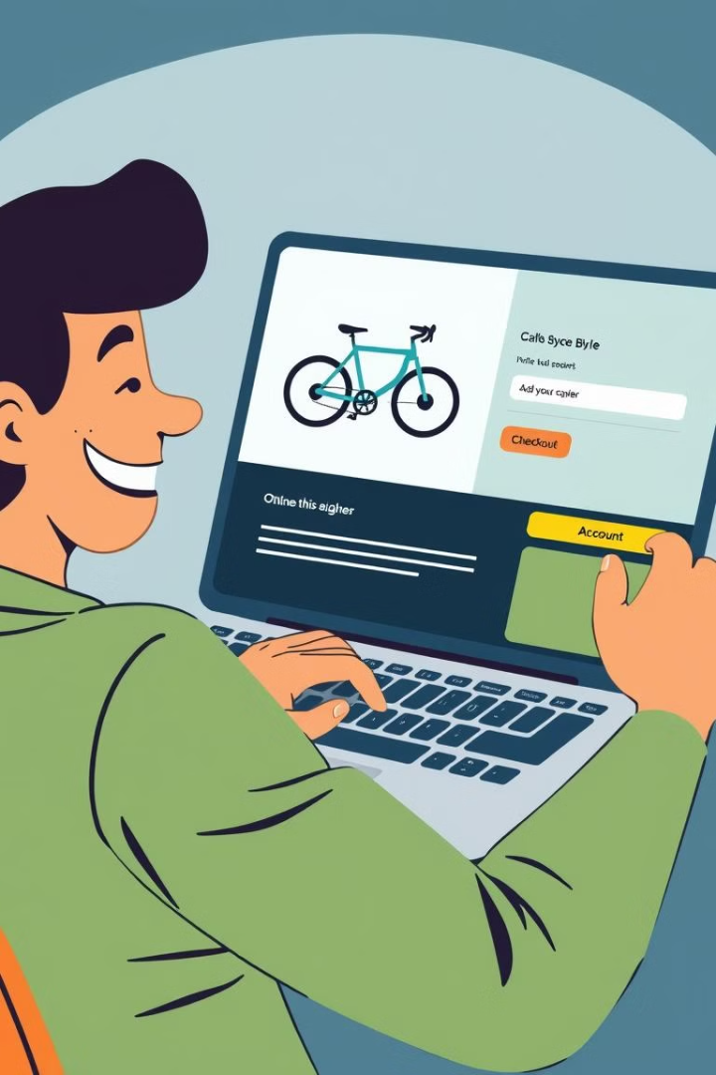
Functionality: Ensure a Smooth and Seamless User Experience
Shopping Cart
Provide a user-friendly shopping cart that allows customers to easily add, remove, and update items, and proceed to the checkout process.
Checkout
Implement a streamlined checkout process with secure payment options and clear order summary information, minimizing friction for customers.
Account Management
Offer customers the ability to create and manage their account, track orders, and access their purchase history and preferences.

Slide 9
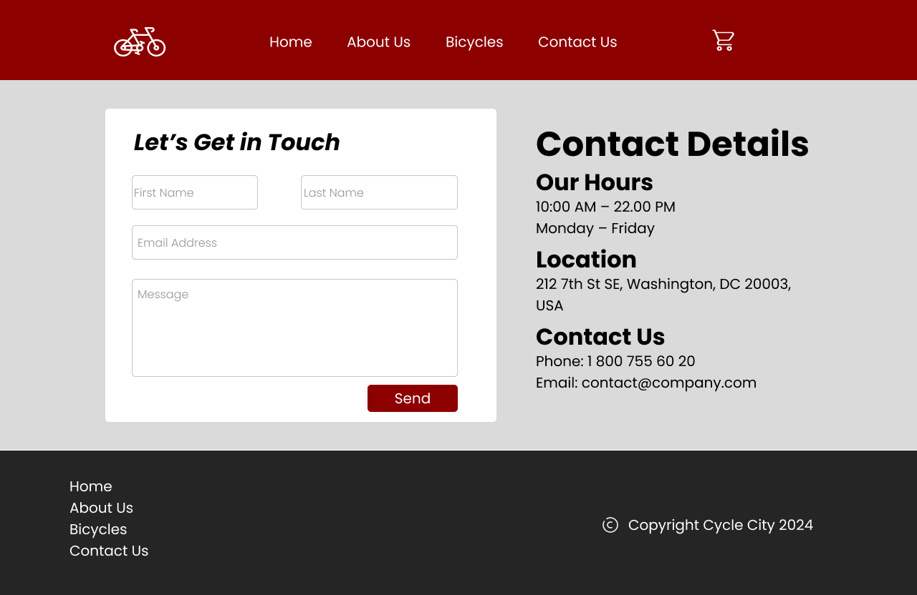
Conclusion: Summarize the Key Website Requirements
1
Product Showcase
2
User-Friendly Navigation
Prominently display the store's bicycle collection, highlighting featured and best-selling models.
Implement a clear and intuitive navigation system, allowing customers to quickly find and explore products.
3
Detailed Product Information
4
Seamless Functionality
Provide comprehensive product details, specifications, and high-quality imagery to help customers make informed purchasing decisions.
Ensure a smooth and seamless user experience, with a user-friendly shopping cart, checkout process, and account management features.

Slide 10
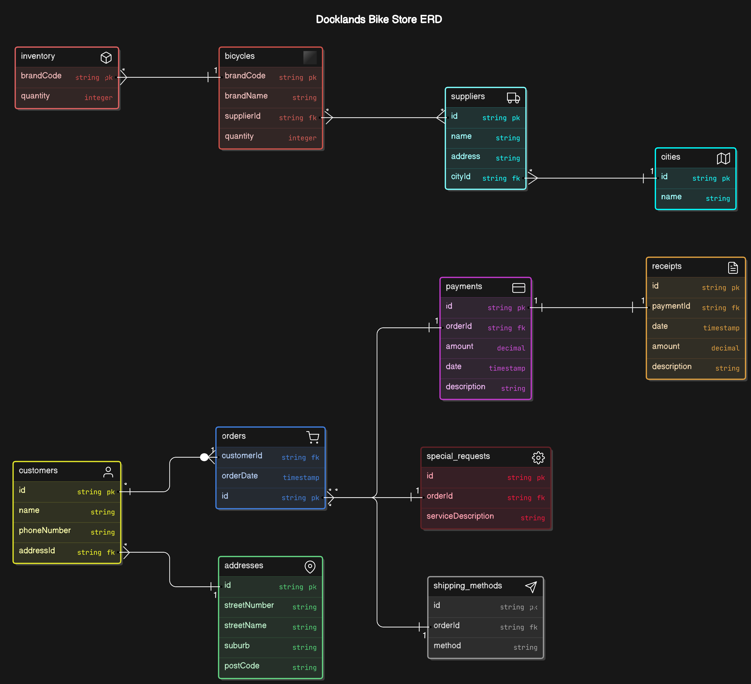
ERD

